Slide 1
2025
CV Management System

Slide 2
CONTENTS
1
Problem
2
How to solve?
3
CV Management System
4
Tools used

Slide 3
Problem
PART ONE
01
The main problem of an HR is having lots of time organizing, collecting information and interacting with a CV

Slide 4

01
STEP HERE
Imagine with me
Imaging being an HR and having a big folder with lots of CVs with different extensions and your boss asked you to bring the recruiters who are good at java and were graduated from Cairo University and fluent in English

Slide 5





01
Problem
Adam
Ahmed
Graduated from Ein shams but he’s good at java
Fluent in English, graduated from Cairo University but not good at java
Ali
Hamza
Good at java, Fluent in English but not graduated from Cairo University
Fluent in English, graduated from Cairo University and good at java

Slide 6
01
Problem
Did you notice?
You cannot positively influence your life when you are not emotionally strong. Strength comes from within.
Did you notice how much time the HR wasted just to find one recruiter?

Slide 7
How to solve?
PART TWO
02
The only way to solve this problem is by having a system that can collect CVs data, enable easy and flexible search and data organizer

Slide 8
02
How to solve?
Java English Cairo University
Skills
Hamza
Language
Fluent in English, graduated from Cairo University and good at java
Education

Slide 9


02
How to solve?
What did we accomplish?
-99%
-99%
Time
Money

Slide 10
CV Management System
PART THREE
03
Our application contains all of these features and more

Slide 11
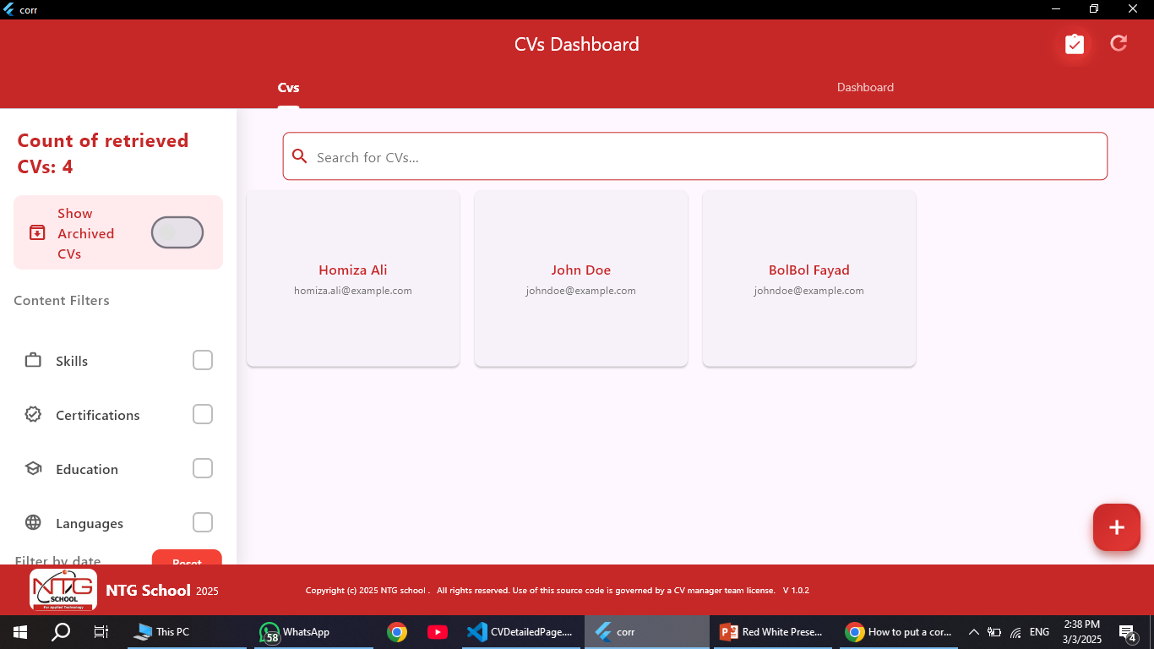


03
CV Management System
Main Page
The main page were you can add CVs, search for CVs and else…

Slide 12
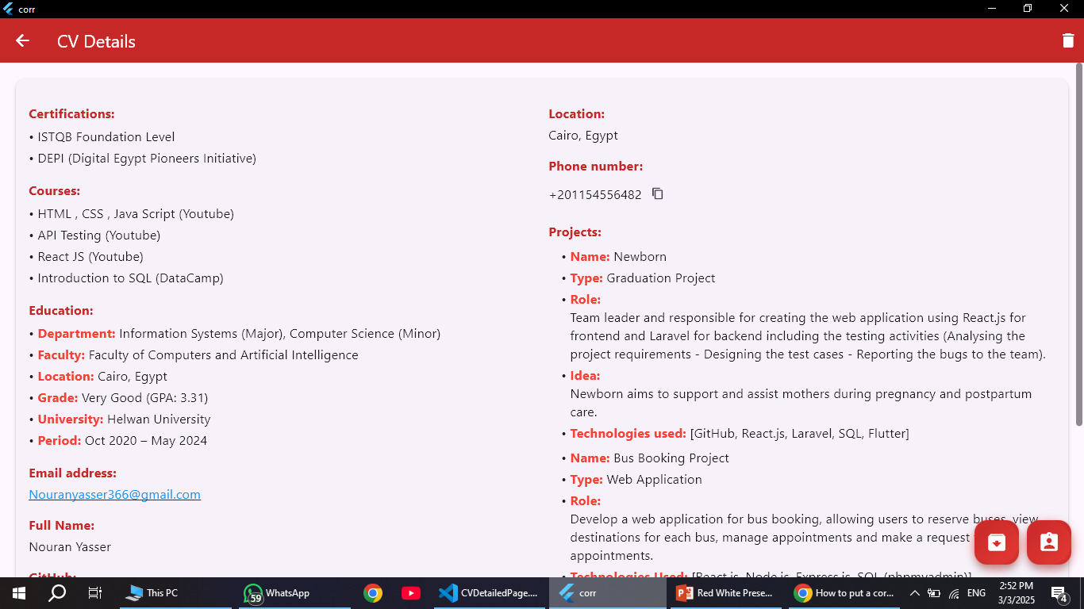
03
CV Management System
“
Let’s see the details of a CV

Slide 13
03
CV Management System
“
Let’s see the details of a CV
I can save the CV as one of the assigned recruiters or I can archive them so that the HR can return to them later

Slide 14
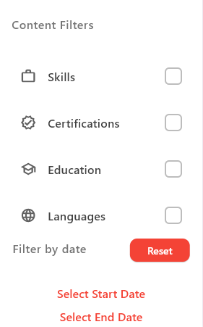
03
CV Management System
Filter by specific categories

Slide 15
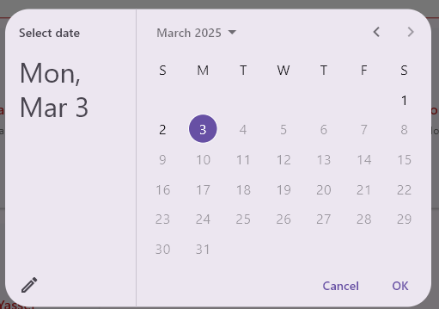
03
CV Management System
Filter by specific categories
Filter by date uploaded

Slide 16
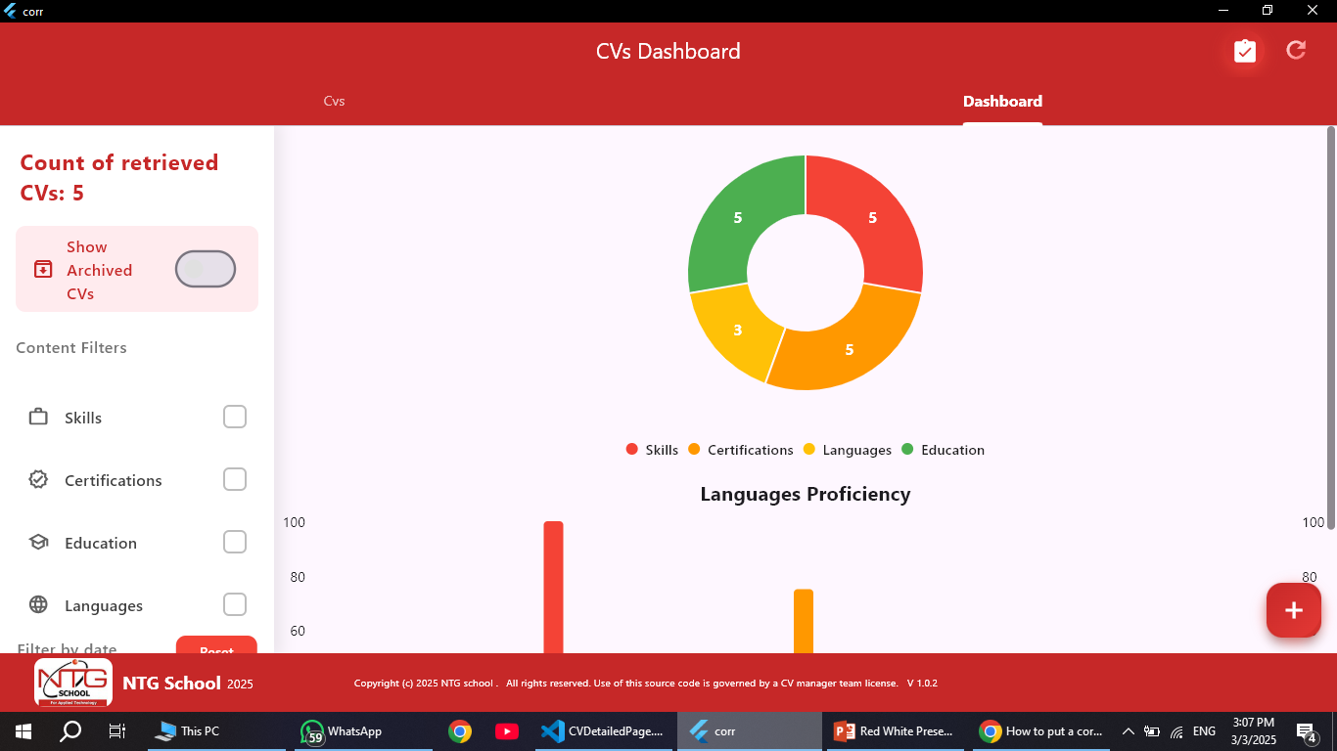
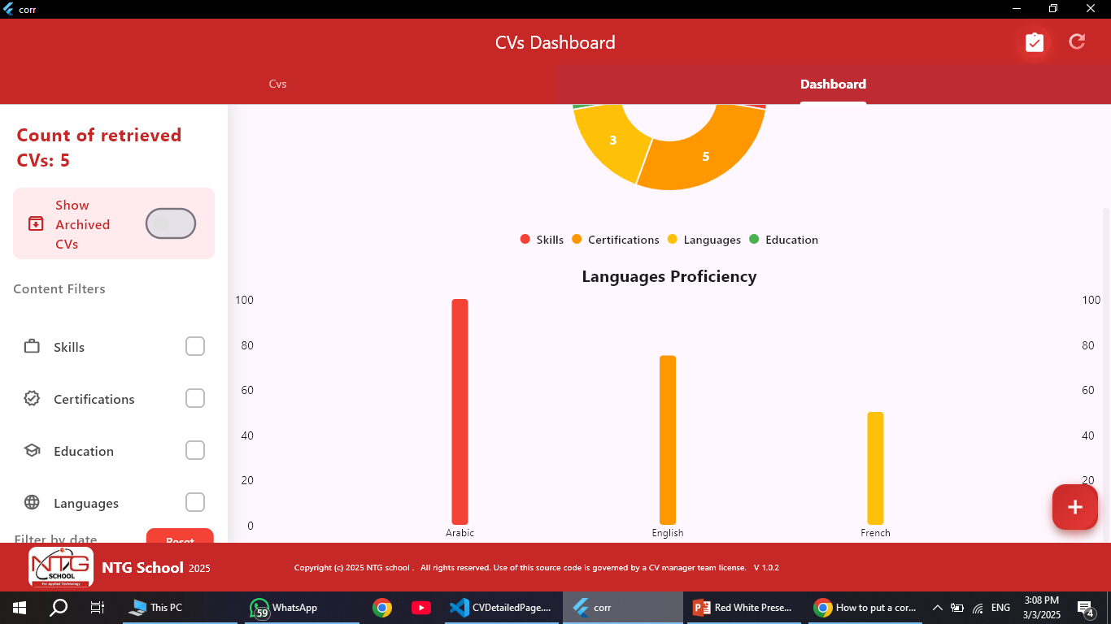
04
CV Management System
DashBoard
DashBoard that helps the HR to know general information about the CVs he has

Slide 17
Tools used
PART FOUR
04
A several tools were used to make CV Management System application

Slide 18



04
Tools used
Flutter
Cloud Fire Store
Google Cloud
(For handling UI)

Slide 19

04
Tools used
Google Cloud
Responsible for data reading
Using a python script that extracts the text from the CV file (.pdf, .docx, .txt) and upload it to a generative ai model in the google cloud to rearrange the data in a .json file format
Google Cloud

Slide 20
04
Tools used
Firebase
To save the data in un-structured form
Why?
Because not all CVs can have the same data
Cloud Fire Store

Slide 21
2025
THANK YOU !
Our Team:
Gamal Waleed – Bilal Ahmed
Youssef Sayed – Marwan Amr
Hamza Mohamed – Somaya Alaa
Seif Sayed – Nour Eldin Tarek

